Slide 1
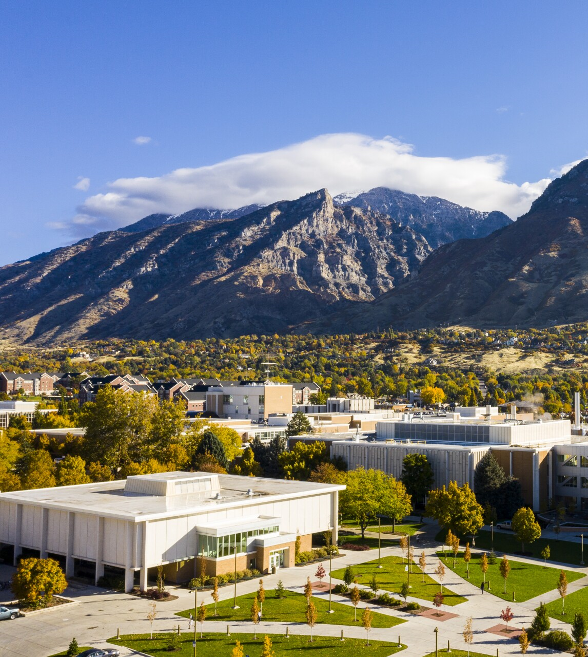

Development Toward an In-Situ Thermal Conductivity Measurement Device for MSRs
Jacob Numbers, Andrew Christensen, Tyler Hamm, McKay Sumsion, Spenser Larson, Ryan Ruth, Troy Munro
Notes:
Jake Numbers, Master’s student BYU

Slide 2
Presentation Outline
Molten Salt Thermal Conductivity
Conclusion
Past Measurement Efforts
Future Measurement Efforts
Initial System Developments
Notes:
Previous models: empirical to first-principles, solid to gas spectrums, issues (actinides)

Slide 3
Molten Salt Thermal Conductivity

Slide 4
Foundational Challenges
Known thermo-physical properties
Accurate modeling
Optimized salt selection
Licensed MSR designs
Competitive energy cost
Mix and temp-dependent models
Effect of nuclear fuel on molten salts
Molecular models of molten salts
Optimizing salt selection for MSRs requires characterization of thermophysical properties
Viscosity
Density
Heat Capacity
Thermal Conductivity
If measurements can’t serve as a shortcut, models can provide parameterized support
Models require validation with measurements
Property estimation,
Fitting methods
Bulk property measurements
Liquid thermal theories
Validation
Notes:
Thousands of salt options, have to consider impact on chemical stability, melting/boiling points, transport properties, neutronics, corrosion potential, availability/cost, waste management, and thermal properties
Necessitates property confidence across numerous compositions and temperatures
Build this characterization of references measurements, but where limited, can provide theoretical property models
Our research deals with measuring these properties for salts to capture composition and temp-dependence, and developing models, especially for actinides—ideal for GenIV+ reactor designs

Slide 5
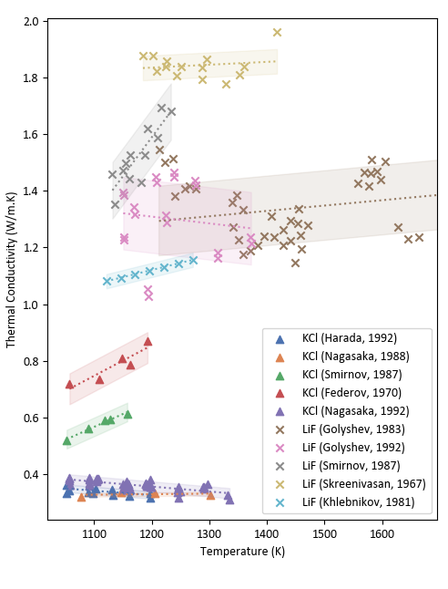
Thermal Conductivity
Thermal conductivity — least measured with largest measurement uncertainty in the Molten Salt Thermal Properties Database (MSTDB)¹
MSRs predicted to be especially sensitive to thermal conductivity^{2,3}
Need to build confidence in thermal conductivity characterization³⁴
Especially lacking actinide measurements
5 actinide-bearing salts
26 thermal conductivity measurements
820 salt compositions in MSTDB-TP^{[4]}
18%
12%
9%
4%
Density
Viscosity
Thermal Conductivity
Heat Capacity
Thermal conductivity measurements of LiF and KCl^{4,5,6,7,8,24}
Notes:
Just heard the great work at ORNL on amassing thermophysical properties database for molten salts, includes density, viscosity, TC, heat capacity
Due to challenges of molten salt (corrosivity, electrical conductivity, high temp rad/convection effects), TC especially hard
Very sparse (only 2 of 801 salts in database are actinides with measurements)
Uncertainty is relatively high
Modeled scenarios of heat transfer coefficient shows TC especially influential.
In a fueled molten salt reactor, composition and temps subject to change and so we want to be confident in how resultant thermal conductivity changes

Slide 6
Past Measurement Efforts

Slide 7
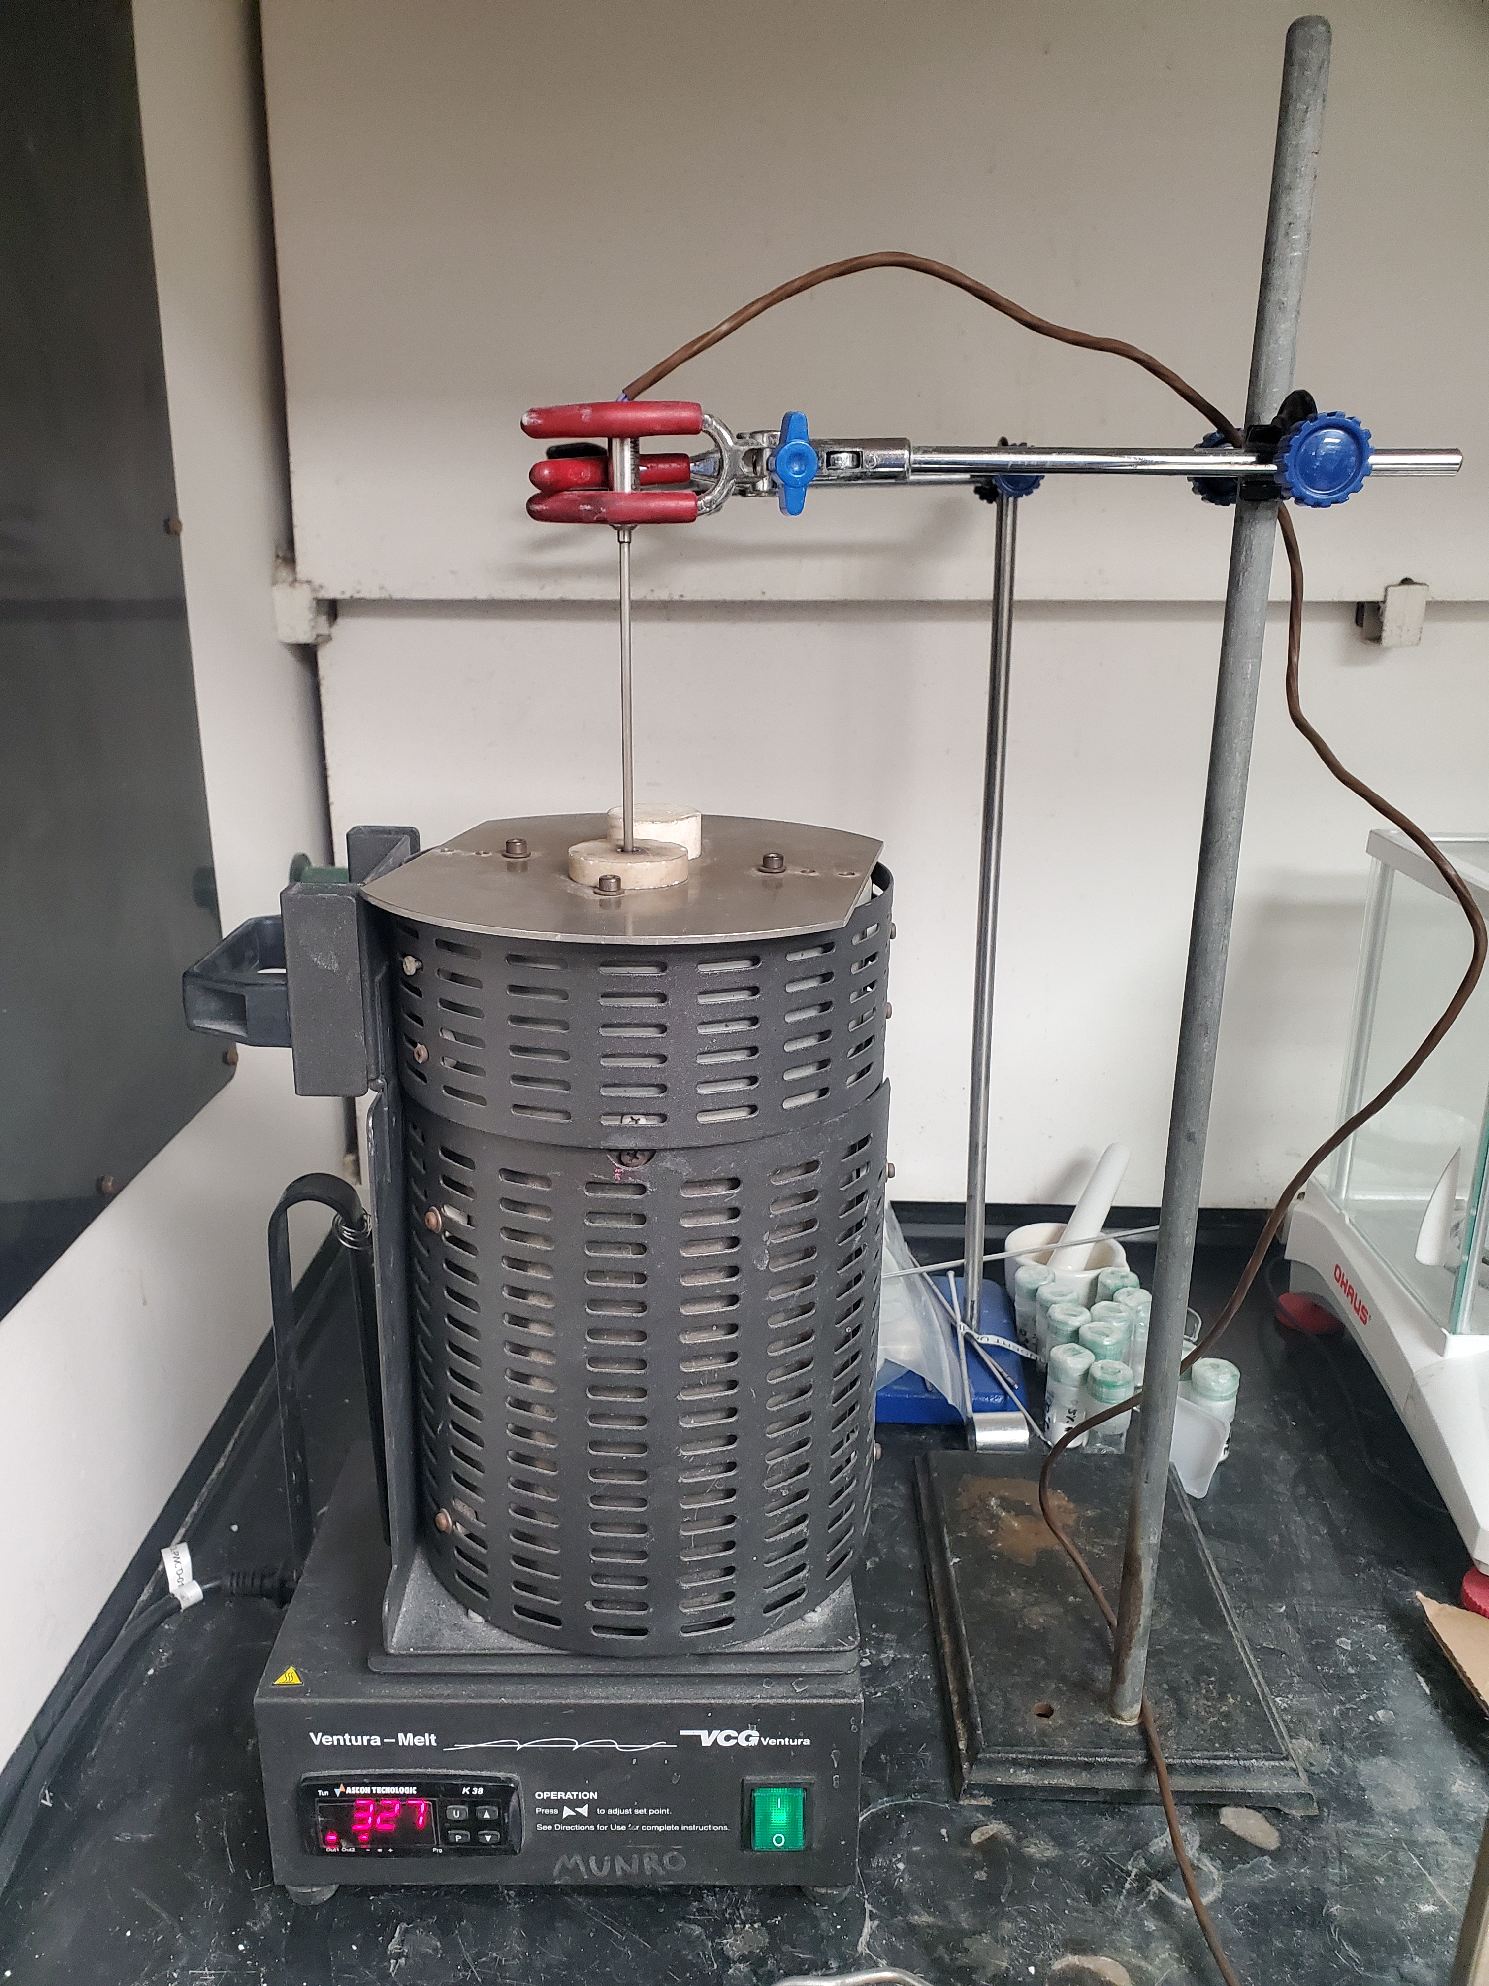
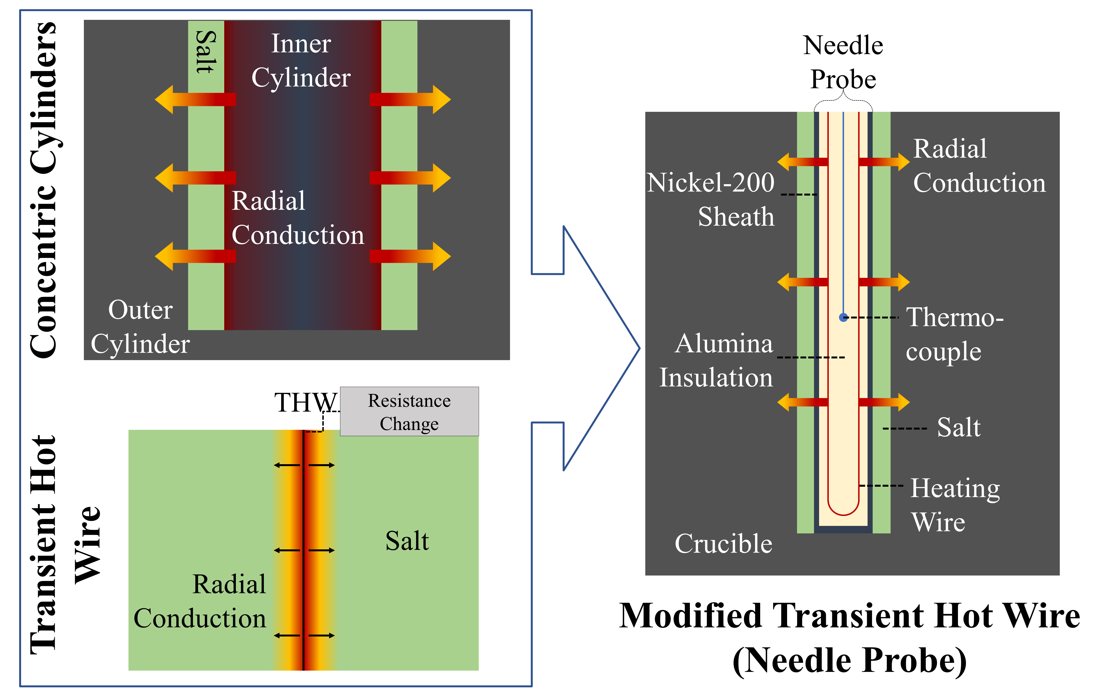
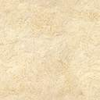
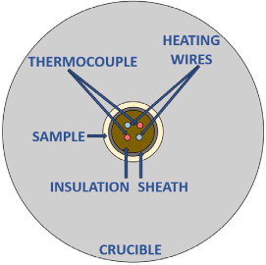
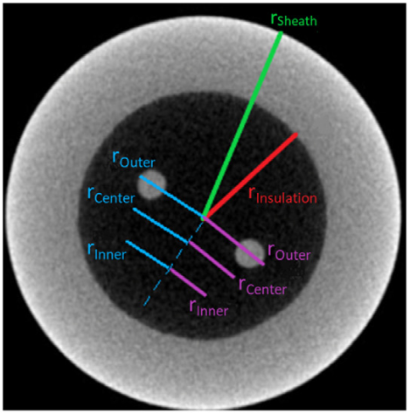
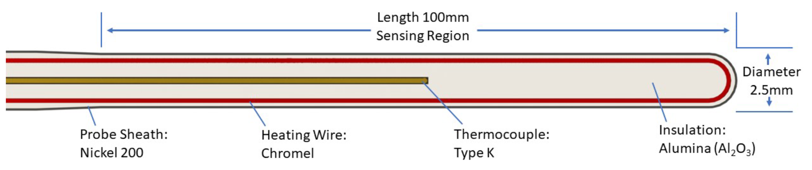
Needle Probe
Notes:
Fabricated by INL—a modified combination of concentric cylinders and transient hot wire methods:
Thermocouple gives a point measurement source that avoids edge effects
Concentric cylinders controls convection by constraining
Can assume parallel planes if ratio of inner diameter to layer thickness is high enough, calculate Rayleigh number

Slide 8
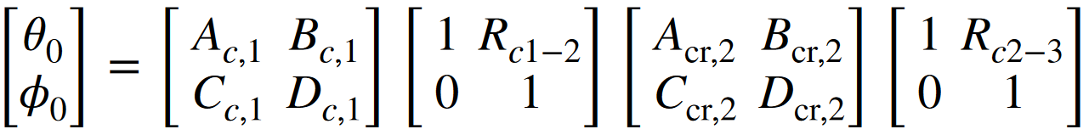
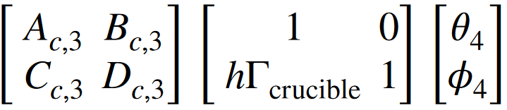
Measurement Process – Needle Probe
1. Prepare salt composition for measurement
2. Electrically insulated thermocouple measures transient response to Joule heating in heater wire
3. Thermal quadrupoles analytical model is solved for thermal conductivity of salt to match temperature profiles from data and model
4. Test repeated across temperature range of salt to obtain temperature dependence of salt composition thermal conductivity
Notes:
transient thermal conductivity measurement method with a comprehensive analytical model that solves for molten salt thermophysical properties
Thermal quadrupoles method takes the whole heat diffusion equation and separates it into layers
Brian Merritt’s modified transient hot-wire

Slide 9
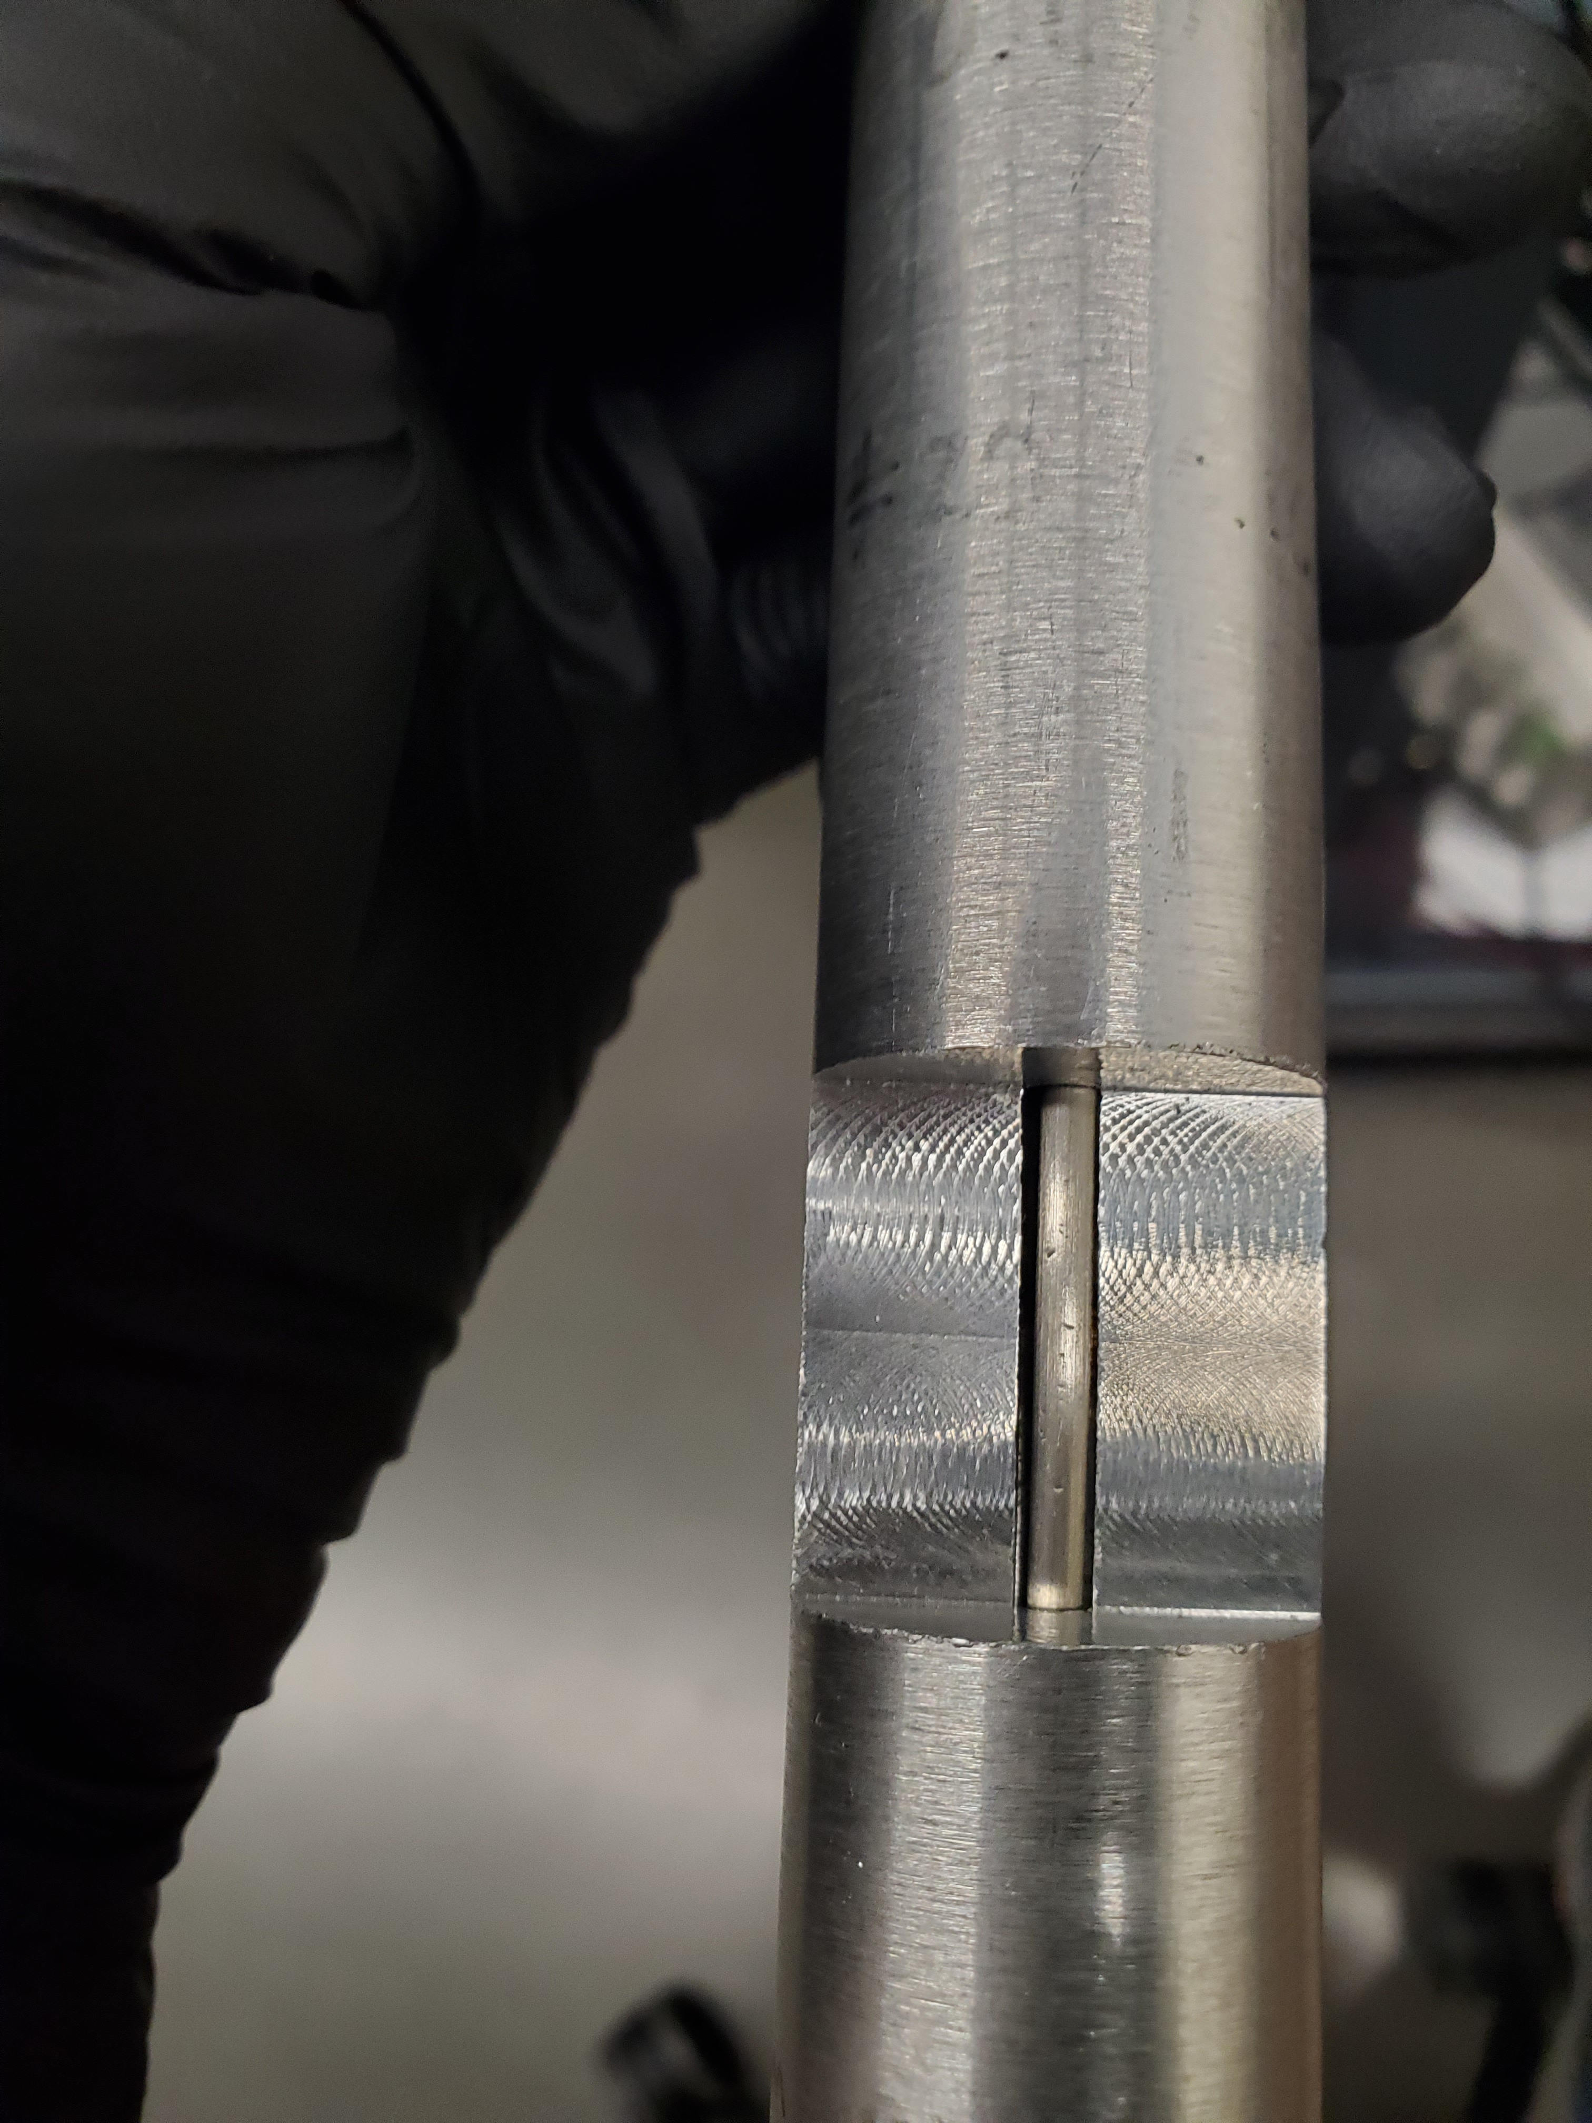
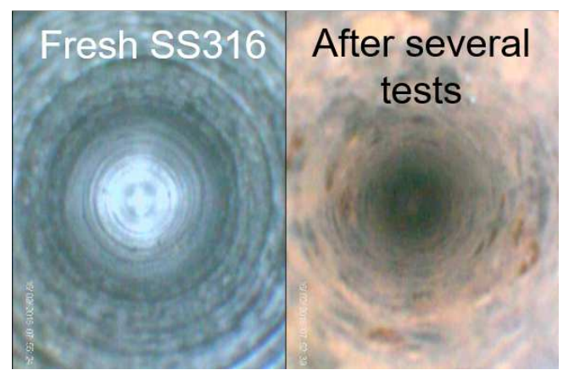
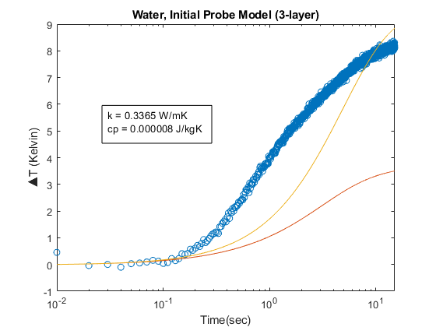
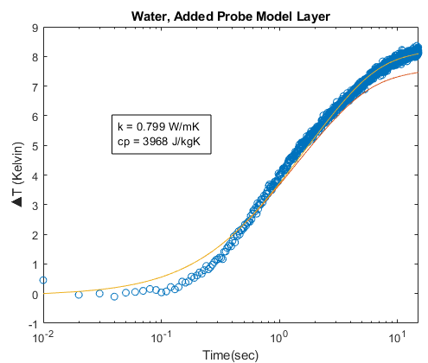
Needle Probe Challenges
Diminishing Measurement Accuracy:
Analytical model requires accurate system geometry and properties—complicated by deformation, cracked alumina, changes to probe thermal properties over time
Needed to better account for these changes in the analytical model— needed a calibration approach.
Difficult to maintain clean, repeatable crucible, which would be especially necessary for future actinide-salt tests
1. Needed a method to determine the internal probe properties
2. Needed a more repeatable crucible for actinide salts
Corrosion/Salt Deposition
Ensuring Probe Alignment
Water, Lumped Probe Model
Water, 3-Layer Probe Model
Initial Model
Initial Model
Solved Model
Solved Model
Notes:
Over time, the probe performance degrades
Need to figure out how to track these changes and modify the analytical model accordingly

Slide 10
Probe Calibration

Slide 11
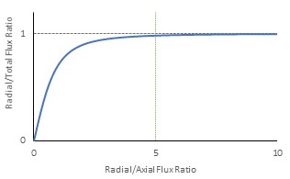
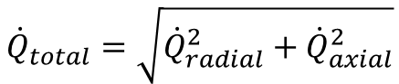
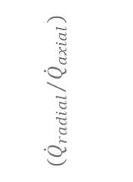
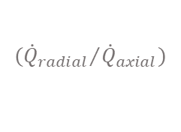
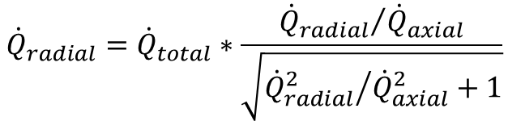
Needle Probe Calibration
Solving for Probe Properties
Inspired by similar calibration approaches of thermal conductivity apparatus^{[1]}, attempted using argon as calibration material—used for the inert glovebox atmosphere.
Argon’s much lower thermal conductivity posed risk of increasing axial-to-radial heat flux ratio, potentially invalidating the input q=radial heat flux assumption.
Needed to determine suitability of argon as calibration material.
If the radial-to-axial heat flux > 5, can assume that the radial heat flux ≈ the total heat flux
To accurately model heat diffusion through the probe, the radial heat flux ≈ the total heat flux; at what point is this not the case?
$${\dot{Q}}_{total}=\sqrt{{\dot{Q}}_{radial}^{2}+{\dot{Q}}_{axial}^{2}}$$
$${{(\dot{Q}}_{radial}}/{{\dot{Q}}_{axial}})$$
$${\dot{Q}}_{radial}={\dot{Q}}_{total}∗\frac{{{\dot{Q}}_{radial}}/{{\dot{Q}}_{axial}}}{\sqrt{{{\dot{Q}}_{radial}^{2}}/{{\dot{Q}}_{axial}^{2}}+1}}$$
$${{(\dot{Q}}_{radial}}/{{\dot{Q}}_{axial}})$$
[1] Termini, N., Birri, T., Smith, B., Chesser, R., Numbers, J., Garland, K., Wilgocki, E., Gray, C., & Glezakou, V. (2024). FY24 progress report on viscosity and thermal conductivity measurements of nuclear industry relevant chloride salts: An experimental and computational study.
Notes:
ORNL used helium as a calibration material for their thermal conductivity measurement device
Our glove boxes at BYU are filled with argon.
We were worried that argon would be too resistive and we would get too much radial heating in the probe
Used FlexPDE 2D and COMSOL 3D to validate the heating was axi-symmetric when using argon.
We found that argon was a good calibration material and wouldn’t impede our test results. it was axi-symmetric for the necessary run time of 100 seconds

Slide 12
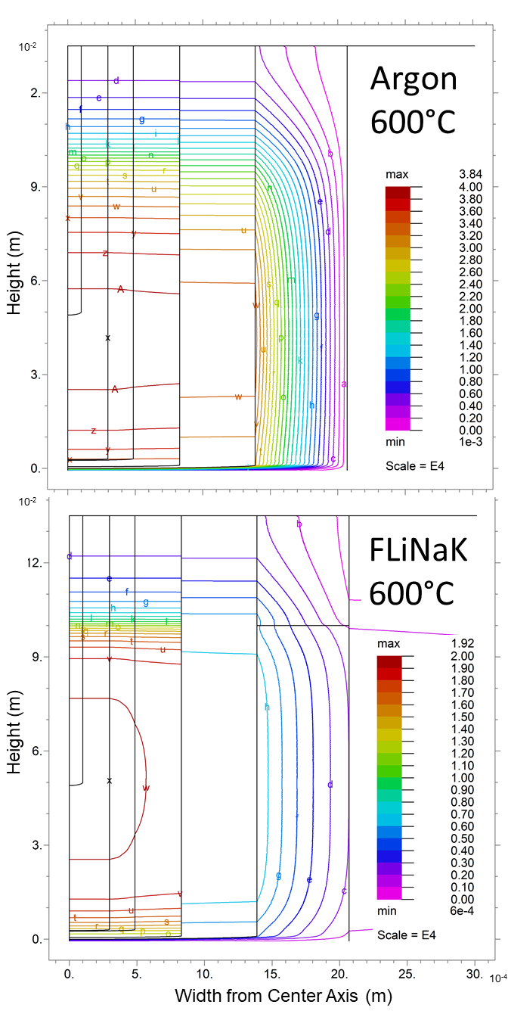
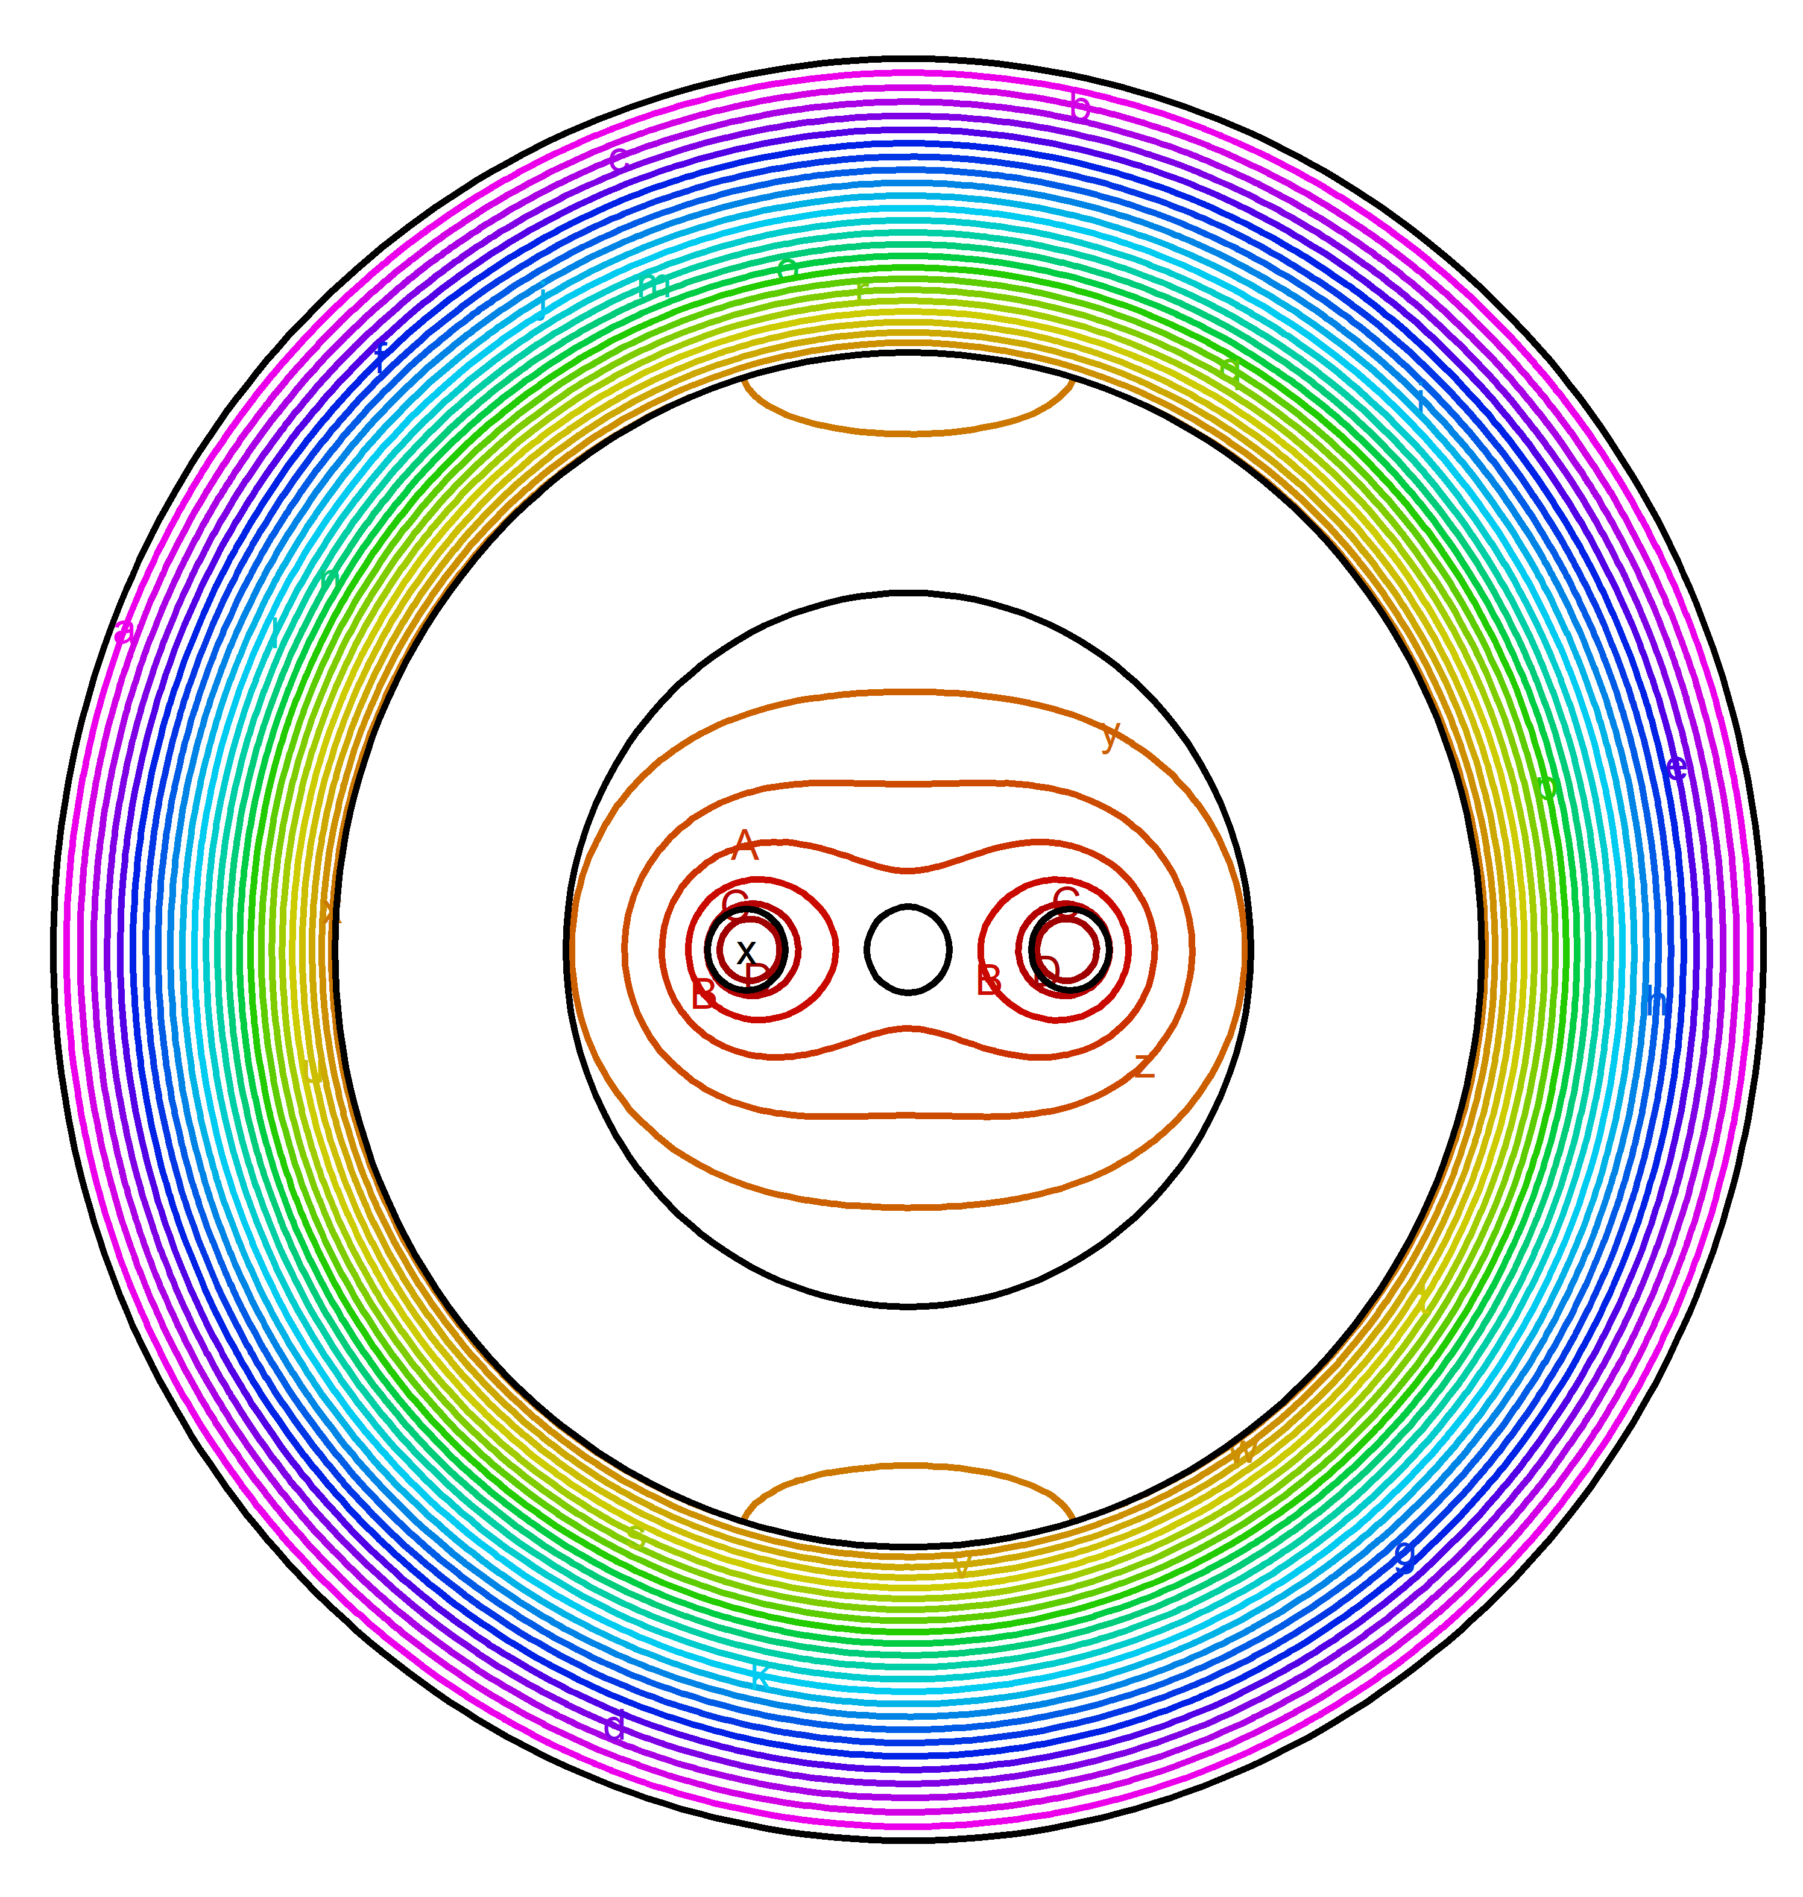
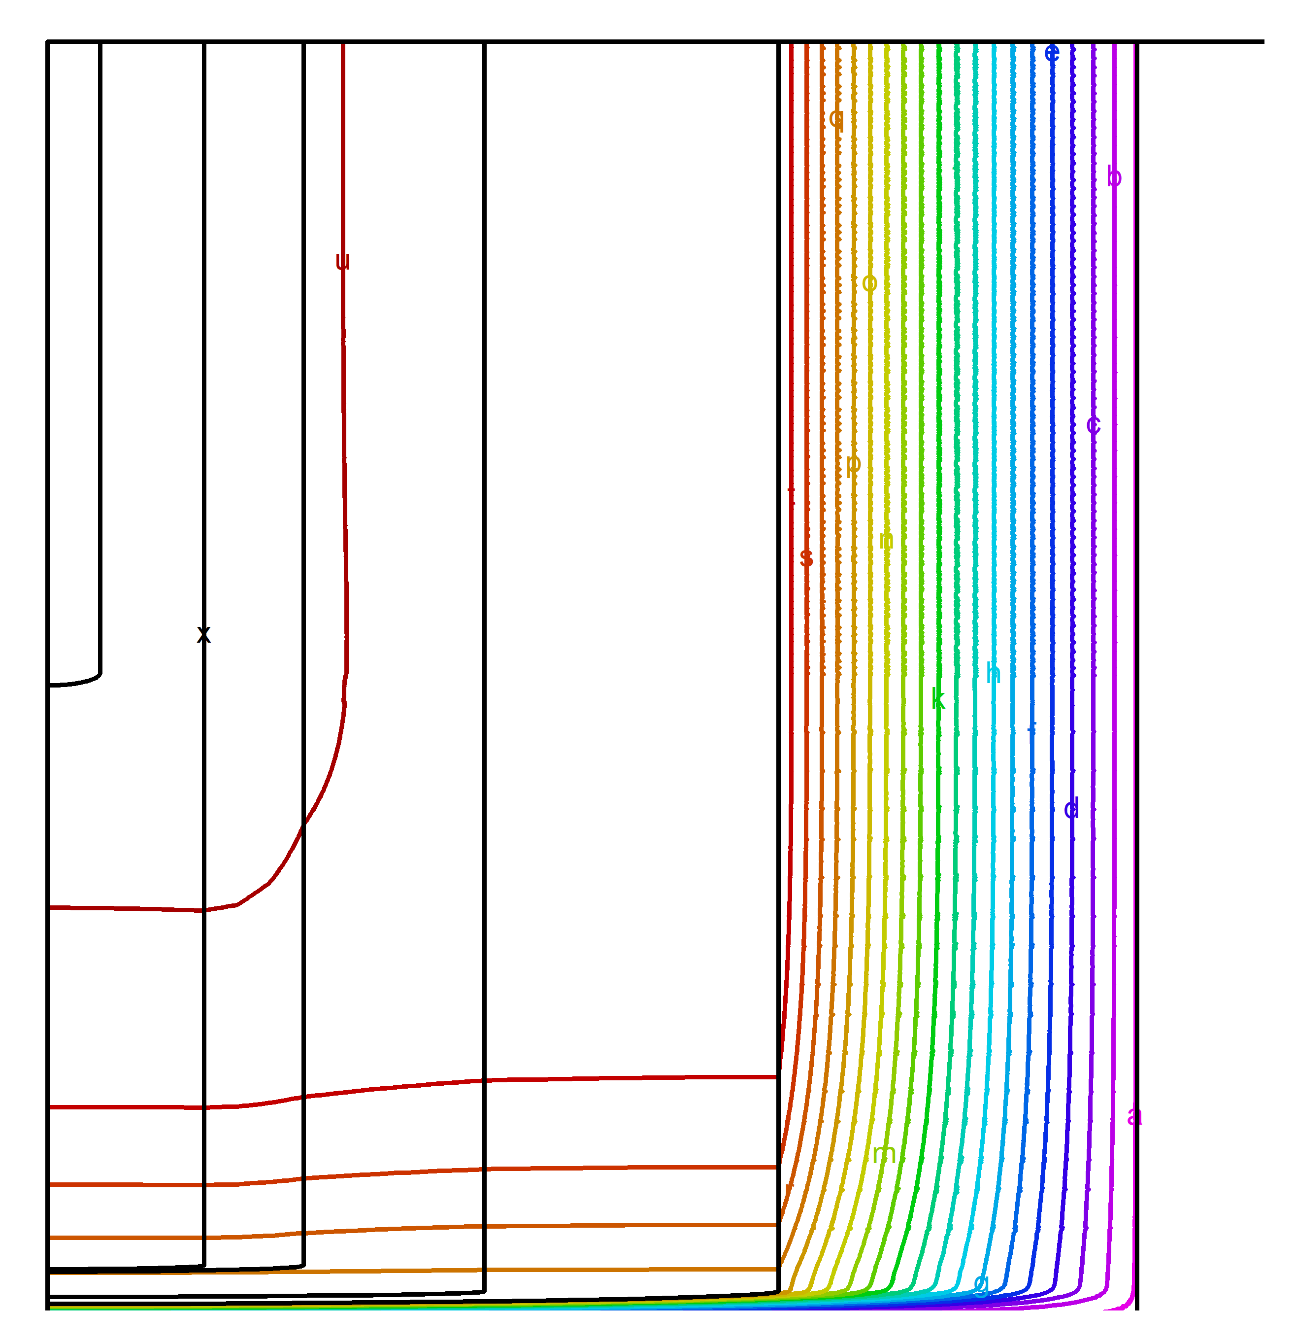
Needle Probe Calibration
Modeling Axial and Radial Heat Flux
FlexPDE^{[1]} – fast PDE solver to produce analytical temp profile with 2-D model
Allows higher fidelity of internal probe properties
Can be iteratively integrated in MATLAB solution code
Comparing horizontal vs vertical cross-section to verify assumptions
Validated axisymmetric head diffusion through sample layer for both salts and argon
Qualitatively similar uniform temperature distribution at height of thermocouple weld for salt and argon
Thermocouple
Insulation
Sample
Thermocouple
Heating Wire
Sheath
Insulation
Sheath
Crucible
Sample
Heating Wires
Crucible
[1] PDE Solutions Inc. (n.d.). FlexPDE 7 [Finite element modeling software].
Notes:
Our glove boxes at BYU are filled with argon.
We were worried that argon would be too resistive and we would get too much radial heating in the probe
Used FlexPDE 2D and COMSOL 3D to validate the heating was axi-symmetric when using argon.
We found that argon was a good calibration material and wouldn’t impede our test results. it was axi-symmetric for the necessary run time of 100 seconds

Slide 13
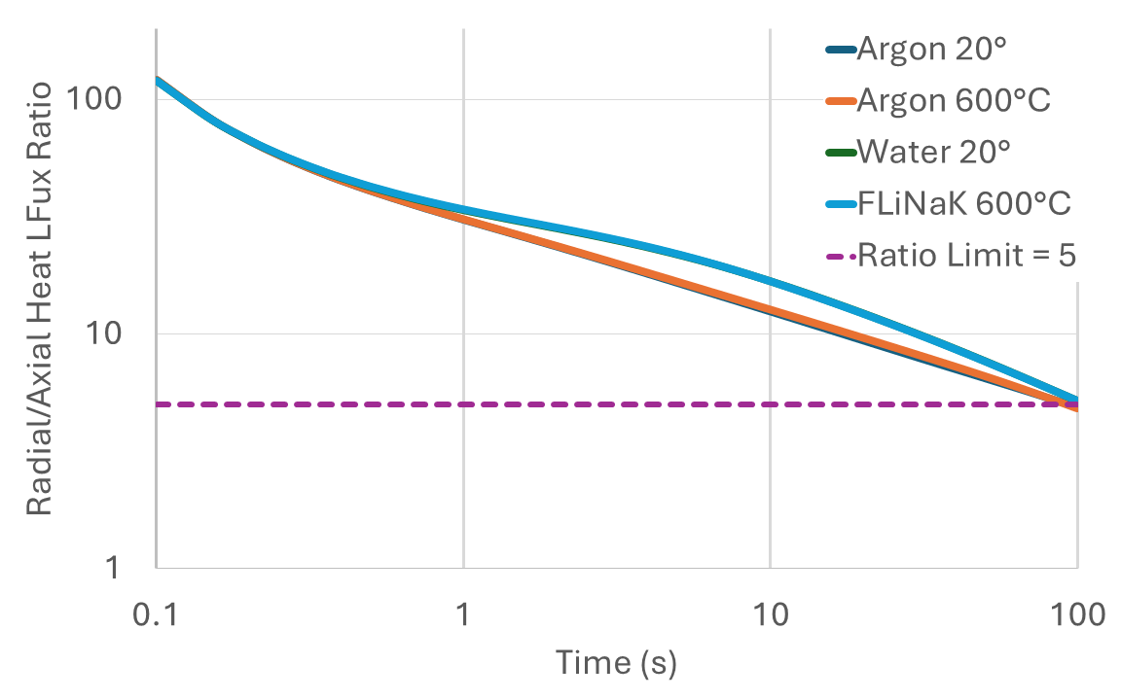
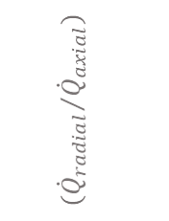
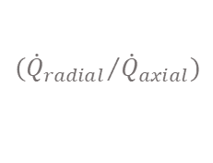
Needle Probe Calibration
Modeling Axial and Radial Heat Flux
Calculated the surface integral of axial and radial heat flux, normalized by surface area.
Plotted the ratio of radial-to-axial fluxes over time (see right)
For all samples simulated (water, FLiNaK, and argon), the ratio remained above 5 for at least 92 seconds—typical measurements are 60s intervals
Argon was determined to be a suitable calibration material
$${{(\dot{Q}}_{radial}}/{{\dot{Q}}_{axial}})$$
$${{(\dot{Q}}_{radial}}/{{\dot{Q}}_{axial}})$$
Notes:
Our glove boxes at BYU are filled with argon.
We were worried that argon would be too resistive and we would get too much radial heating in the probe
Used FlexPDE 2D and COMSOL 3D to validate the heating was axi-symmetric when using argon.
We found that argon was a good calibration material and wouldn’t impede our test results. it was axi-symmetric for the necessary run time of 100 seconds

Slide 14
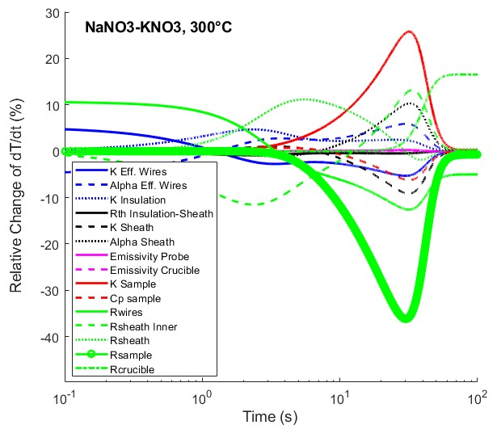
Needle Probe Calibration
Solving for Probe Properties
NIST-tabulated reference values of argon^{[1,2]} fixed the sample properties
Used MATLAB solver to fit an analytical model to experimental measurements of argon by solving for 12 model properties of the probe:
— Effective heating layer
— Alumina insulation
— Nickel sheath
— Internal wire position
— Effective probe geometry
— Radiative properties
A sensitivity analysis with these calibrated properties (seen right) indicates the relative time range of maximum sensitivity to the sample thermal conductivity
Used an approximate formula residual-error calculation^{[1]} to account for unknown variability in solved properties. This provided uncertainty range for final Monte Carlo analysis that would calculate the total uncertainty that included parameter variability.
Calibrated model was then applied to solve for molten salt thermal conductivity
Duration of max sensitivity to sample k
[1] Faber, N. (Klaas) M., 2002. Uncertainty estimation for multivariate regression coefficients. Chemometrics and Intelligent Laboratory Systems 64, 169–179. https://doi.org/10.1016/S0169-7439(02)00102-8
Notes:
Our glove boxes at BYU are filled with argon.
We were worried that argon would be too resistive and we would get too much radial heating in the probe
Used FlexPDE 2D and COMSOL 3D to validate the heating was axi-symmetric when using argon.
We found that argon was a good calibration material and wouldn’t impede our test results. it was axi-symmetric for the necessary run time of 100 seconds

Slide 15
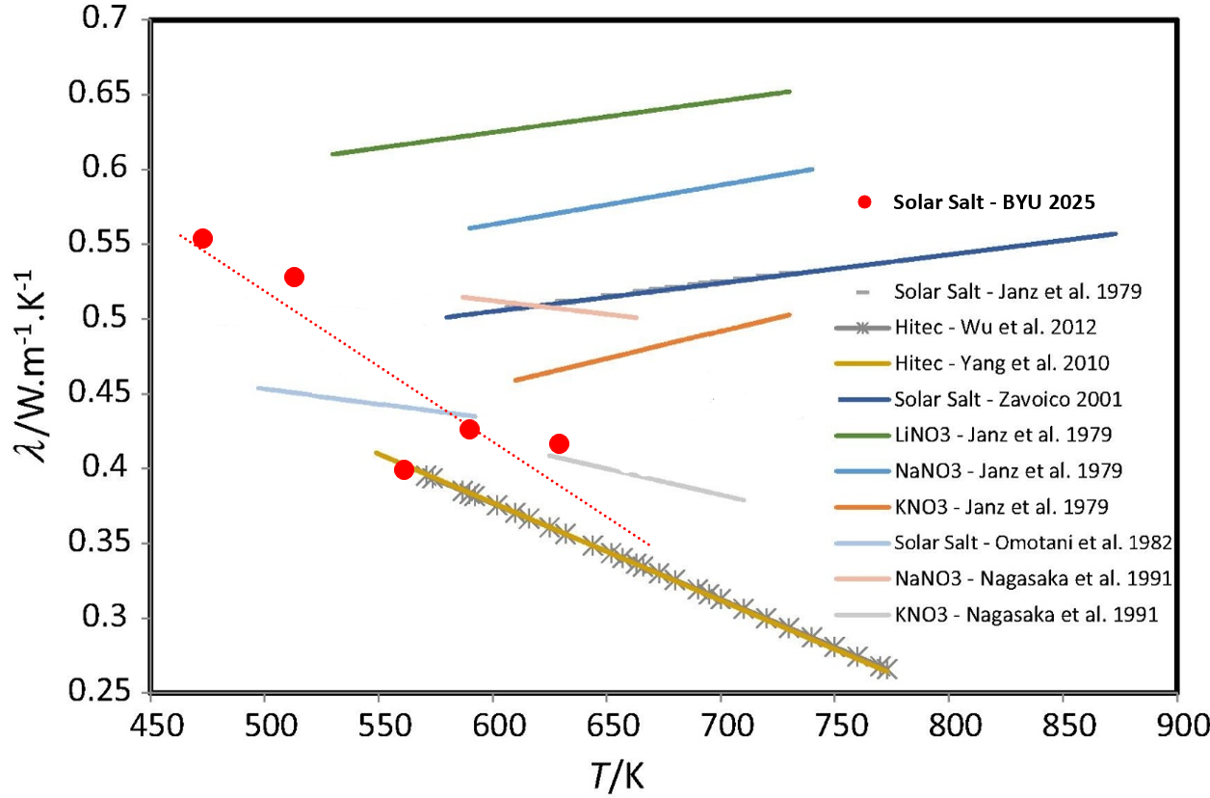
Calibrated Needle Probe
Probe Performance
The calibrated probe obtained repeatable and reasonable values for nitrate salt thermal conductivity.
Solar salt (NaNO₃-KNO₃) an ideal validation salt due to other experimental values in literature.
The calibrated probe was used to quickly conduct compositional studies of nanoparticles in solar salt (publication forthcoming).
Limitations
Only used for salt measurements below 400°C (per the working temperature range of solar salts)
Initial attempts to calibrate at higher temperatures complicated by nonlinear probe behavior—may indicate complex changes with temperature inside probe
Comparison of BYU needle probe measurements of solar salt (eutectic NaNO3-KNO3). Adapted from Nunes et. al., 2016^{[1]}
[1] V.M.B. Nunes, C.S. Queirós, M.J.V. Lourenço, F.J.V. Santos, C.A. Nieto de Castro, Molten salts as engineering fluids – A review: Part I. Molten alkali nitrates, Applied Energy, Volume 183, 2016
Notes:
Our glove boxes at BYU are filled with argon.
We were worried that argon would be too resistive and we would get too much radial heating in the probe
Used FlexPDE 2D and COMSOL 3D to validate the heating was axi-symmetric when using argon.
We found that argon was a good calibration material and wouldn’t impede our test results. it was axi-symmetric for the necessary run time of 100 seconds

Slide 16
Further Probe Developments
Notes:
While successful application to a variety of chloride and fluoride molten salts, regular use resulted in eventual deviation from the model that prevented its continued implementation.
To extend functionality and inform future iterations, a method of calibration using argon gas was developed: see data
This came in handy bc now we have a new objective
We are now trying to design a system (build our own probe) where we measure thermal conductivity and composition of the salt. This work is done in conjunction with another group at byu. Our objective is to make an probe that allows us to measure thermal conductivity and act as the counter electrode to measure composition.
The crucible lacking the through hole made it hard to clean and would limit our ability to keep track of uranium, so we designed a new crucible with through hole
We also moved away from nickel 200 to Inconel for higher temperature range for creep
Want to apply probe to more salts (actinides, at higher temperature ranges). Actinides need cleanable system inside glovebox, need to change probe sheath to make higher temp-tolerant

Slide 17
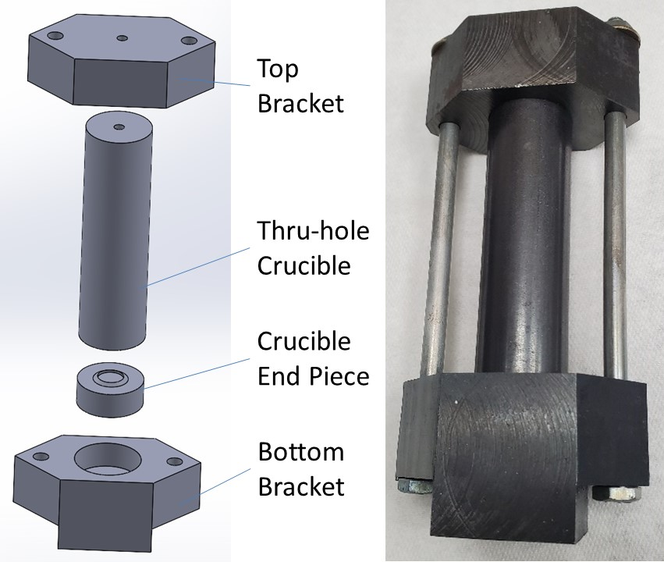
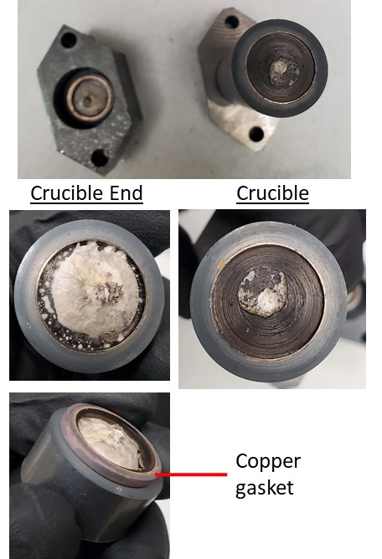
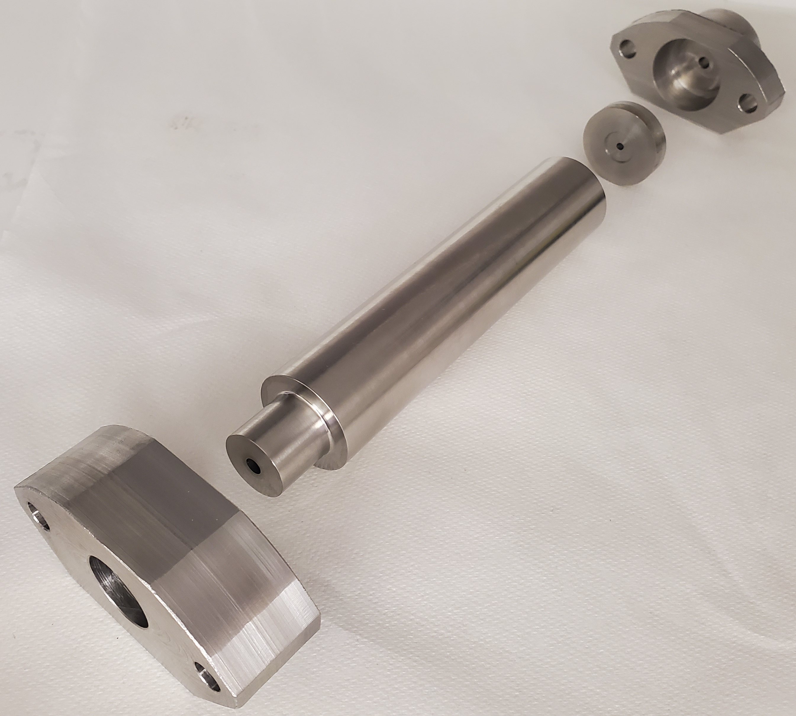
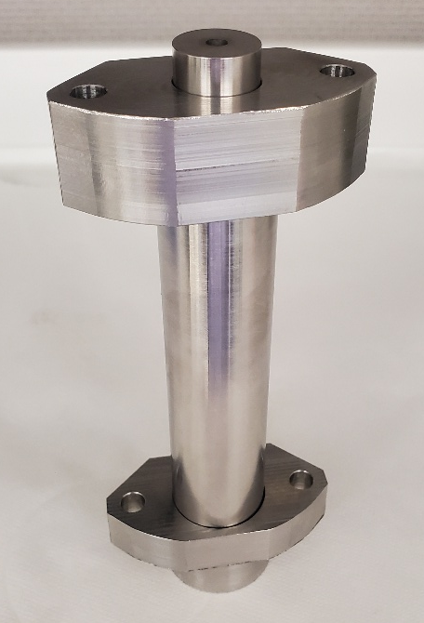
Crucible V2
Through-hole permits mechanical cleaning for actinide salts inside glovebox
Knife edge cuts into gasket and forms unpressurized seal
Prototyped with mild steel and leak check
Current version of Inconel-625 crucible (resistant to corrosion)
Leak test with nitrate salts in mild steel crucible prototype
Inconel-625 through-hole crucible

Slide 18
Potential Prototype Design
Epoxy sealant
Main Probe Sheath
Powder
Top portion sticks out of furnace; lower thermal conductivity is ideal, so can be powder filled then sealed with epoxy or potting ceramabond
(Ideally) Wider mouth for extra wires
TC Wires
Voltage Sensing Wires
Power Supply Wires
6-wire region
Design decisions:
We will assemble probe in stages using 10, 1cm long AlN solid core segments allowing us to break for thermocouple.
During assembly, sheath will be filled with AlN Ceramabond, and then the threaded core segments will be pushed down the sheath to allow ceramabond to fill gaps
Heating Wires
4-wire region
Testing region
TC Junction
1cm solid core segments x 10
greater density → greater thermal conductivity → greater sensitivity to salt thermal properties
2-wire region

Slide 19
Potential Prototype Design
Epoxy sealant
Main Probe Sheath
Internal assembly
Powder
(Ideally) Wider mouth for extra wires
1
2
3
TC Wires
Power Supply Wires
6-wire region
Fill sheath with ceramabond, press assembled core into sheath
Voltage Sensing Wires
BN coated walls of assembly mold
Remove from mold, weld wires
Heating Wires
4-wire region
Testing region
TC Junction
1cm solid core segments x 10
greater density → greater thermal conductivity → greater sensitivity to salt thermal properties
2-wire region

Slide 20
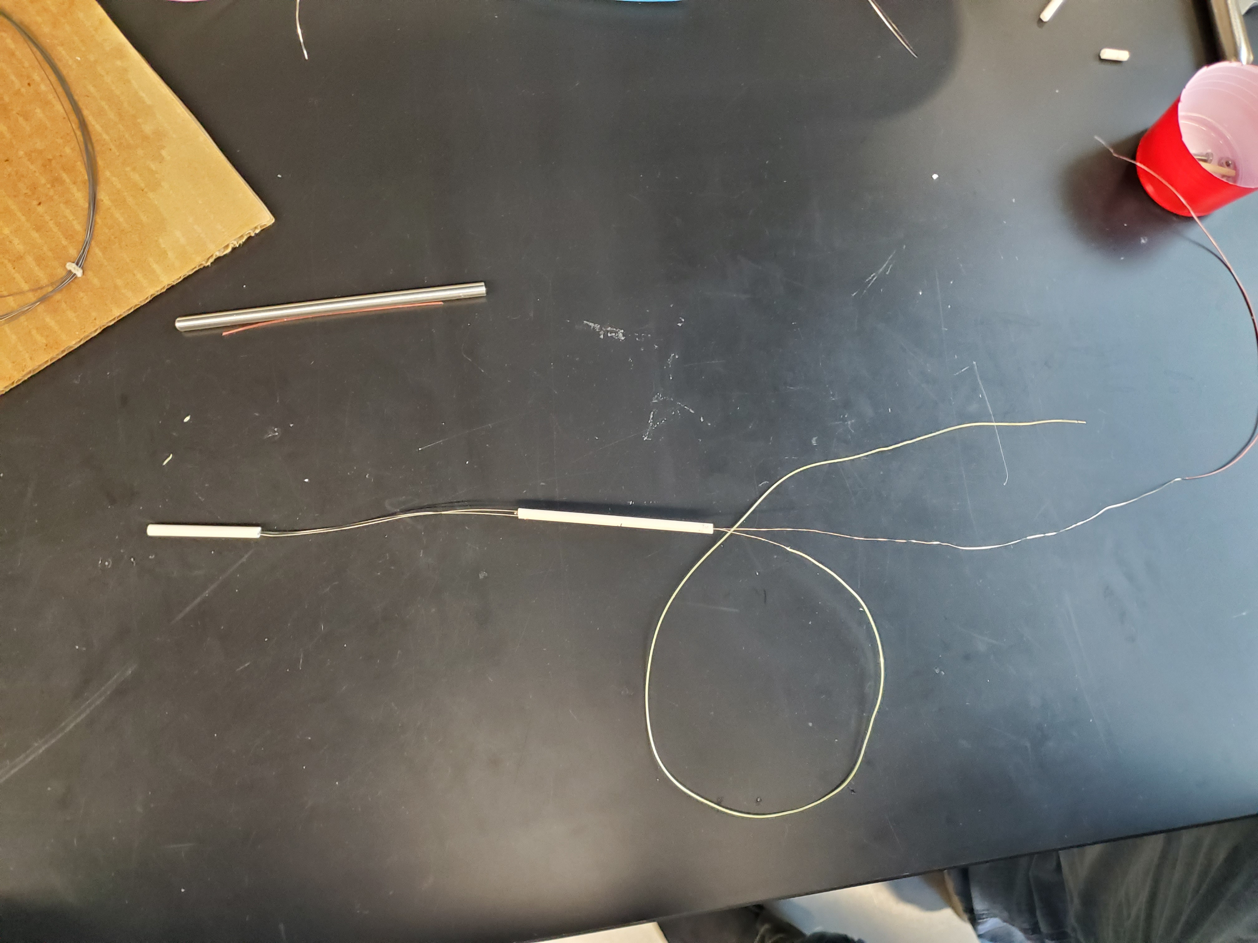
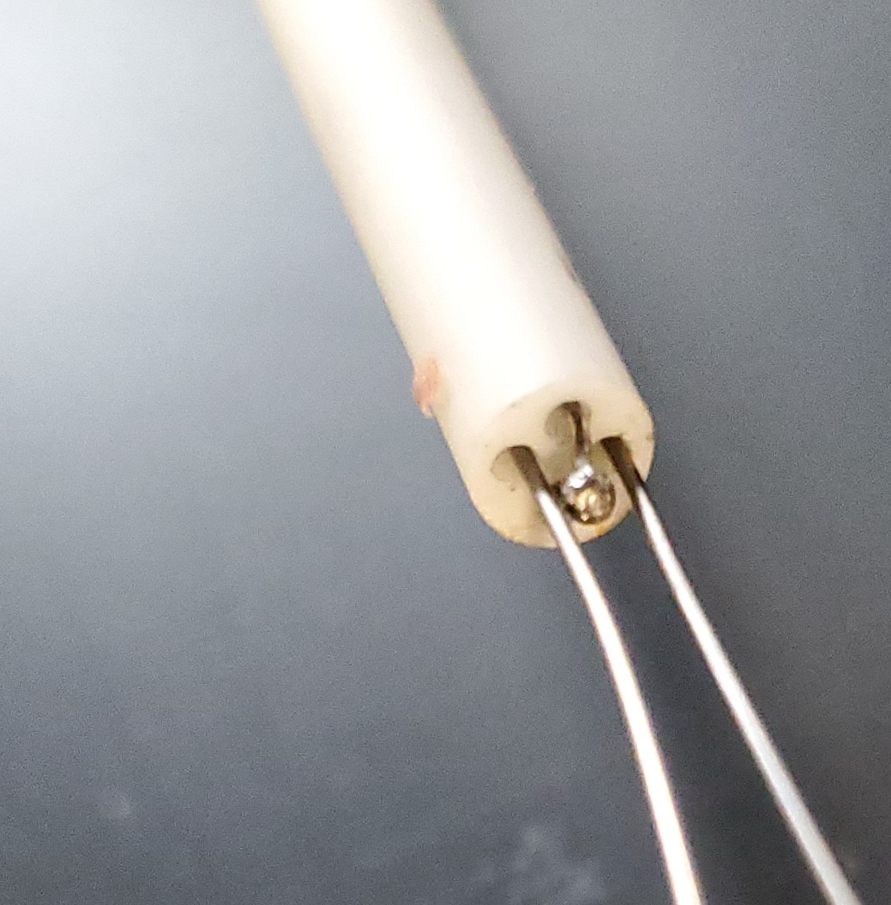
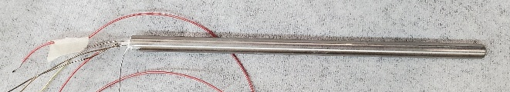
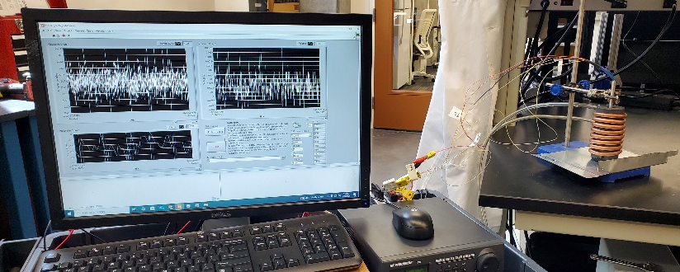
Probe Prototypes
Iteration Process
Fabricate variation of probe with internally insulated heating wires, thermocouple, and voltage sensing wires
Measure reference material (water initially, then argon).
Input probe geometry into model and solve for the prototype’s layers’ thermal properties
Conduct sensitivity analysis to evaluate prototype performance
Ideal: and high sensitivity to sample thermal conductivity
Initial Prototypes
Current versions intended to practice probe assembly; these involve large-diameter sheaths (relatively) and perform very poorly according to sensitivity analysis of solved probe properties, but are instructive for fabrication process.
Initial testing is done outside of glovebox using water as initial reference liquid (up to the 80°C)
Unassembled probe internal components (alumina core segments, thermocouple, heating wires).
Initial probe prototype with SS304 sheath, alumina core, BN suspension filling
Experimental testing setup
Notes:
aluminum nitride powder: high thermal conductivity, high electrical resistance
Efforts so far have been to develop process of prototyping and evaluating, later this year will have working probes

Slide 21
Conclusions

Slide 22
Conclusions
A calibration approach enables longer use and accuracy of needle probe, in addition to improved design tools for thermal conductivity system
Improvements to the design of the needle probe and testing setup will enable higher-temperature measurements of more relevant molten salts, including actinide-bearing mixtures
The minimal sample size, short measurement times, and apparatus repeatability makes the needle probe ideal for collection of multiple salt compositions to capture temperature dependence.
Ideal
Measurement Temperature Range (K)
VGA
CC
NP
Size according to avg. standard deviation of data
LFA
TGS
weeks
days
hours
minutes
seconds
22

Slide 23
Upcoming Work
Validate probe prototype with commonly measured molten salts (FLiNaK, chloride unary salts)
Measure across compositions for actinide-bearing salts:
FLiNaK-UF₄
NaCl-UCl₃
Develop predictive thermal conductivity model for actinide-bearing salts
Ideal
Measurement Temperature Range (K)
VGA
CC
NP
Size according to avg. standard deviation of data
LFA
TGS
weeks
days
hours
minutes
seconds
23

Slide 24

Acknowledgements
Funding for this research has come from the Department of Energy, Nuclear Energy University Program (NEUP): Award #DE-NE0009502.
Special thanks to Dr. Troy Munro who advised this research and student researchers at Brigham Young University (Jacob Numbers, Andrew Christensen, Isaac Walker, Sam Nasman, Hailey Snodgrass, McKay Sumsion) and collaborators at Oak Ridge National Laboratory.

Slide 25
References
Oak Ridge National Laboratory, U. of South Carolina, T. Besman, N. D. B. Ezell, T. Birri, N. Termini, S. Henderson, and J. Schorne-Pinto. (2024) Molten salt thermal properties database. [Online]. Available: https://mstdb.ornl.gov/
Creasman, Sarah. “Sensitivity Analysis of Thermophysical Properties of Molten Salts Using a Molten Salt Demonstration Reactor Model in TRANSFORM.” Doctoral Dissertations, May 1, 2023. https://trace.tennessee.edu/utk_graddiss/8160.
Freile, Ramiro, and Mark Kimber. “Influence of Molten Salt-(FLiNaK) Thermophysical Properties on a Heated Tube Using CFD RANS Turbulence Modeling of an Experimental Testbed.” Edited by Jan Leen Kloosterman, Elsa Merle, and Jean Ragusa. EPJ Nuclear Sciences & Technologies 5 (2019): 16. https://doi.org/10.1051/epjn/2019027.
Golyshev, Vladimir D. “Experimental Investigation of the Thermal-Conductivity of Transparent Melts”, TVT, 21:5 (1983), 899–903; High Temperature, 21:5 (1983), 684–687,” 1983. https://www.mathnet.ru/php/archive.phtml?wshow=paper&jrnid=tvt&paperid=6160&option_lang=eng.
Golyshev, Vladimir D. “High-Temperature Thermophysical Properties of Nonscattering Semitransparent Materials I: Methods and Instrumentation for the Determination of Spectral Absorptivity and Thermal Conductivity of Melts,” no. 4 (1992): 367–77.
Khlebnikov, O. E., V. A. Sokolov, I. E. Veneraki, and A. N. Alabovsky. “Determination of Thermal Conductivity Coefficients of Lithium, Magnesium, Calcium, and Barium Fluorides in the Liquid State.” Thermophysical Properties of Substances 5 (1981): 97–101.
Harada, Makoto, Akihisa Shioi, Tsunetoshi Miura, and Shinsuke Okumi. “Thermal Conductivities of Molten Alkali Metal Halides.” Industrial & Engineering Chemistry Research 31, no. 10 (October 1, 1992): 2400–2407. https://doi.org/10.1021/ie00010a021.
Nagasaka, Y., and A. Nagashima. “Measurement of the Thermal Diffusivity of Molten KCl up to 1000°C by the Forced Rayleigh Scattering Method.” International Journal of Thermophysics 9, no. 6 (November 1, 1988): 923–31. https://doi.org/10.1007/BF01133260.
An, Xue-Hui, Jin-Hui Cheng, Hui-Qin Yin, Lei-Dong Xie, and Peng Zhang. “Thermal Conductivity of High Temperature Fluoride Molten Salt Determined by Laser Flash Technique.” International Journal of Heat and Mass Transfer 90 (November 1, 2015): 872–77. https://doi.org/10.1016/j.ijheatmasstransfer.2015.07.042.
Gallagher, Ryan C., Anthony Birri, Nick G. Russell, Anh-Thu Phan, and Aïmen E. Gheribi. “Investigation of the Thermal Conductivity of Molten LiF-NaF-KF with Experiments, Theory, and Equilibrium Molecular Dynamics.” Journal of Molecular Liquids 361 (September 1, 2022): 119151. https://doi.org/10.1016/j.molliq.2022.119151.
Khokhlov, V., I. Korzun, V. Dokutovich, and E. Filatov. “Heat Capacity and Thermal Conductivity of Molten Ternary Lithium, Sodium, Potassium, and Zirconium Fluorides Mixtures.” Journal of Nuclear Materials 410, no. 1 (March 1, 2011): 32–38. https://doi.org/10.1016/j.jnucmat.2010.12.306.
Merritt, Brian, Michael Seneca, Ben Wright, Noah Cahill, Noah Petersen, Austin Fleming, and Troy Munro. “Thermal Conductivity Characterization of Fluoride and Chloride Molten Salts Using a Modified Transient Hot-Wire Needle Probe.” International Journal of Thermophysics 43, no. 10 (August 10, 2022): 149. https://doi.org/10.1007/s10765-022-03073-2.
Nagasaka, Y., N. Nakazawa, and A. Nagashima. “Experimental Determination of the Thermal Diffusivity of Molten Alkali Halides by the Forced Rayleigh Scattering Method. I. Molten LiCl, NaCl, KCl, RbCl, and CsCl.” International Journal of Thermophysics 13, no. 4 (July 1, 1992): 555–74. https://doi.org/10.1007/BF00501941.
Robertson, Sean G., Ralph Wiser, Wonseok Yang, Dokyu Kang, Sungyeol Choi, Emilio Baglietto, and Michael P. Short. “The Curious Temperature Dependence of Fluoride Molten Salt Thermal Conductivity.” Journal of Applied Physics 131, no. 22 (June 8, 2022): 225102. https://doi.org/10.1063/5.0088059.
Rudenko, Alexey, Alexander Redkin, Evgeniya Il’ina, Svetlana Pershina, Peter Mushnikov, Yuriy Zaikov, Sergey Kumkov, Yalan Liu, and Weiqun Shi. “Thermal Conductivity of FLiNaK in a Molten State.” Materials 15, no. 16 (January 2022): 5603. https://doi.org/10.3390/ma15165603.
Smirnov, M. V., V. A. Khokhlov, and E. S. Filatov. “Thermal Conductivity of Molten Alkali Halides and Their Mixtures.” Electrochimica Acta 32, no. 7 (July 1, 1987): 1019–26. https://doi.org/10.1016/0013-4686(87)90027-2.
V. I. Fedorov, V. I. Machuev, “Thermal Conductivity of Fused Salts”, TVT, 8:4 (1970), 912–914; High Temperature, 8:4 (1970), 858–860. Accessed March 23, 2024. https://www.mathnet.ru/php/archive.phtml?wshow=paper&jrnid=tvt&paperid=7779&option_lang=eng.
Frandsen, Benjamin A., Stella D. Nickerson, Austin D. Clark, Andrew Solano, Raju Baral, Johnny Williams, Jörg Neuefeind, and Matthew Memmott. “The Structure of Molten FLiNaK.” Journal of Nuclear Materials 537 (August 15, 2020): 152219. https://doi.org/10.1016/j.jnucmat.2020.152219.
Giordano, Valentina M., and Giulio Monaco. “Fingerprints of Order and Disorder on the High-Frequency Dynamics of Liquids.” Proceedings of the National Academy of Sciences 107, no. 51 (December 21, 2010): 21985–89. https://doi.org/10.1073/pnas.1006319107.
Revere, M., and M. P. Tosi. “Structure and Dynamics of Molten Salts.” Reports on Progress in Physics 49, no. 9 (September 1986): 1001. https://doi.org/10.1088/0034-4885/49/9/002.
Cahill, David G., S. K. Watson, and R. O. Pohl. “Lower Limit to the Thermal Conductivity of Disordered Crystals.” Physical Review B 46, no. 10 (September 1, 1992): 6131–40. https://doi.org/10.1103/PhysRevB.46.6131.
Gheribi, A.E., A.T. Phan, and P. Chartrand. “A Theoretical Framework for Reliable Predictions of Thermal Conductivity of Multicomponent Molten Salt Mixtures: KCl-NaCl-MgCl2 as a Case Study.” Solar Energy Materials and Solar Cells 236 (2022). https://doi.org/10.1016/j.solmat.2021.111478.
Gheribi, Aïmen E., and Patrice Chartrand. “Thermal Conductivity of Molten Salt Mixtures: Theoretical Model Supported by Equilibrium Molecular Dynamics Simulations.” The Journal of Chemical Physics 144, no. 8 (February 26, 2016): 084506. https://doi.org/10.1063/1.4942197.
Gheribi, Aïmen E., Jesus A. Torres, and Patrice Chartrand. “Recommended Values for the Thermal Conductivity of Molten Salts between the Melting and Boiling Points.” Solar Energy Materials and Solar Cells 126 (July 1, 2014): 11–25. https://doi.org/10.1016/j.solmat.2014.03.028.
Kincaid, John F., and Henry Eyring. “Free Volumes and Free Angle Ratios of Molecules in Liquids.” The Journal of Chemical Physics 6, no. 10 (October 1, 1938): 620–29. https://doi.org/10.1063/1.1750134.
Nagasaka, Y., and A. Nagashima. “Corresponding States Correlation for the Thermal Conductivity of Molten Alkali Halides.” International Journal of Thermophysics 14, no. 4 (July 1, 1993): 923–36. https://doi.org/10.1007/BF00502115.
Yang, Huiqiang, Ryan Gallagher, Patrice Chartrand, and Aïmen E. Gheribi. “Development of a Molten Salt Thermal Conductivity Model and Database for Advanced Energy Systems.” Solar Energy 256 (May 15, 2023): 158–78. https://doi.org/10.1016/j.solener.2023.04.009.
Zhao, Andrew Z., Matthew C. Wingert, Renkun Chen, and Javier E. Garay. “Phonon Gas Model for Thermal Conductivity of Dense, Strongly Interacting Liquids.” Journal of Applied Physics 129, no. 23 (June 21, 2021). https://doi.org/10.1063/5.0040734.
Chliatzou, Ch. D., M. J. Assael, K. D. Antoniadis, M. L. Huber, and W. A. Wakeham. “Reference Correlations for the Thermal Conductivity of 13 Inorganic Molten Salts.” Journal of Physical and Chemical Reference Data 47, no. 3 (September 19, 2018): 033104. https://doi.org/10.1063/1.5052343.
Zhao, Andrew Z., Matthew C. Wingert, and Javier E. Garay. “Frequency-Domain Hot-Wire Measurements of Molten Nitrate Salt Thermal Conductivity.” Journal of Chemical & Engineering Data 66, no. 1 (January 14, 2021): 262–70. https://doi.org/10.1021/acs.jced.0c00621.
Bobrova, K. O., V. N. Dokutovich, and P. N. Mushnikov. “Thermophysical Properties of Several Molten Mixtures of the LiF–BeF2–UF4 System.” Russian Metallurgy (Metally) 2023, no. 2 (February 1, 2023): 126–35. https://doi.org/10.1134/S0036029523020039.
Rose, M. A., L. D. Gardner, T. T. Lichtenstein, S. A. Thomas, and E. Wu. “Property Measurements of NaCl-UCl3 and NaCl-KCl-UCl3 Molten Salts (Rev.1).” Argonne National Laboratory (ANL), Argonne, IL (United States), May 26, 2023. https://doi.org/10.2172/1985295.
Termini, N. Birrit, T. Ezell, D. [Forthcoming] “Thermal conductivity measurements of NaCl-UCl3 using the variable gap apparatus.” Oak Ridge National Laboratory (ORNL), Oak Ridge, TN (United States). April, 2023.
Q. Zheng, M. Hao, R. Miao, J. Schaadt, and C. Dames, “Advances in thermal conductivity for energy applications: a review,” vol. 3, no. 1, p. 012002, publisher: IOP Publishing. [Online]. Available: https://dx.doi.org/10.1088/2516-1083/abd082
Chen, Gang. “Perspectives on Molecular-Level Understanding of Thermophysics of Liquids and Future Research Directions.” Journal of Heat Transfer 144, no. 010801 (November 9, 2021). https://doi.org/10.1115/1.4052657.
Trachenko, Kostya. “Heat Capacity of Liquids: An Approach from the Solid Phase.” Physical Review B 78, no. 10 (September 5, 2008): 104201. https://doi.org/10.1103/PhysRevB.78.104201.

Slide 26
Additional Slides

Slide 27
Needle Probe
Fabricated by INL—a modified combination of concentric cylinders and transient hot wire methods:
Method | Modification | Improvement | Challenges
Concentric Cylinders | Thinner sample annulus (<0.7mm) | Minimize convection and sample size (<3g) | Highly sensitive to concentricity
 | Transient (vs steady-state) | Reduce axial-to-radial losses, shorter test times | Requires complex analytical modeling
Transient Hot Wire | Insulated wires | Reduce EMI and corrosion | Increases test time (order of 10s vs 1s)
 | Thermocouple (vs resistance thermometer) | Fast response time, single probe point (avoid end-effects) | EMI through insulation possible at high temperatures

Slide 28
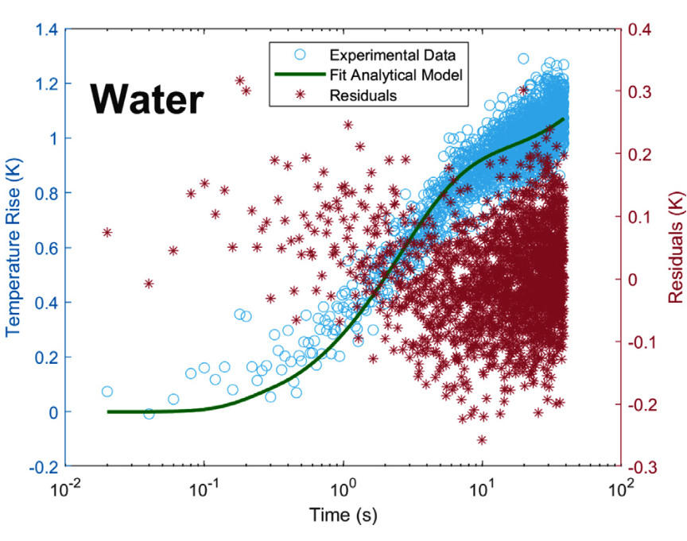
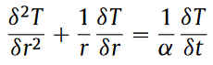
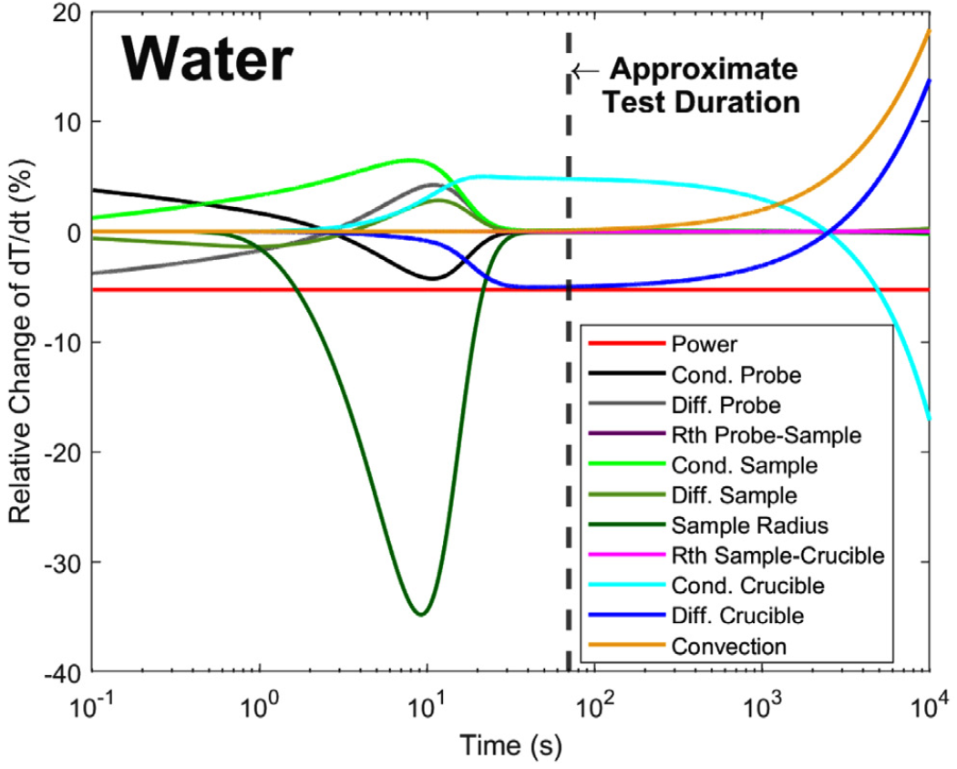
Needle Probe
Solves multi-layer heat diffusion equation for λ and c_{p} (and ρ if needed) to fit the analytical model to the temperature profile
Can select time frame for the fitting process according to regime most influenced by sample properties (from COMSOL sensitivity analysis)
Thermal quadrupoles to solve heat diffusion equations
Transform to Laplace space for solvable algebra
Solve for Laplace heat rate with Bessel functions
Adapt for layers system of equations
Numerically solve for sample properties to fit the analytical temperature to the temperature profile
λ_{sample}, c_{p,sample}, ρ_{sample}
Notes:
Merritt, Maillett

Slide 29
Crucible V2
Through-hole permits mechanical cleaning for actinide salts inside glovebox
Knife edge cuts into gasket and forms unpressurized seal
Prototyped with mild steel and leak check
Current version of Inconel-625 crucible and SS316 brackets

Slide 30
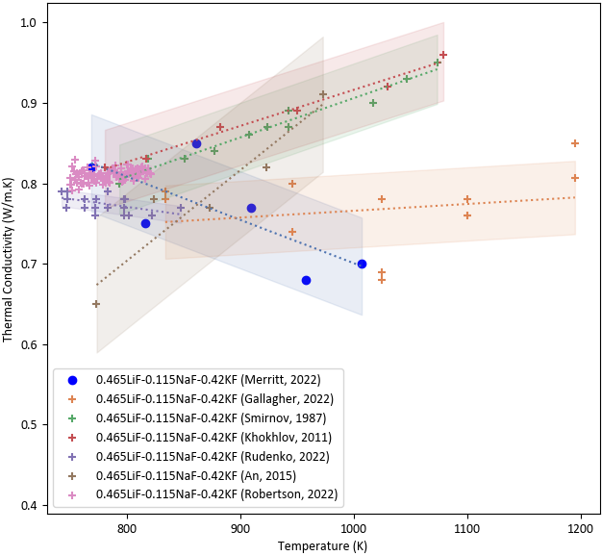
Outlook
Improved design
Due to the minimal required sample size, fast measurement times, and repeatability of apparatus, the needle probe can support collection of multiple salt compositions to capture temperature dependence.
FLiNaK Comparison
Ideal
FLiNaK Measurement Temperature Range (K)
VGA
CC
NP
Size according to avg. standard deviation of data
Needle Probe (NP)
LFA
Variable Gap Apparatus (VGA)
Concentric Cylinders (CC)
Concentric Cylinders (CC)
Laser Flash Analysis (LFA)
TGS
Laser Flash Analysis (LFA)
Transient Grating Spectroscopy (TGS)
weeks
days
hours
minutes
seconds

